Slide 1
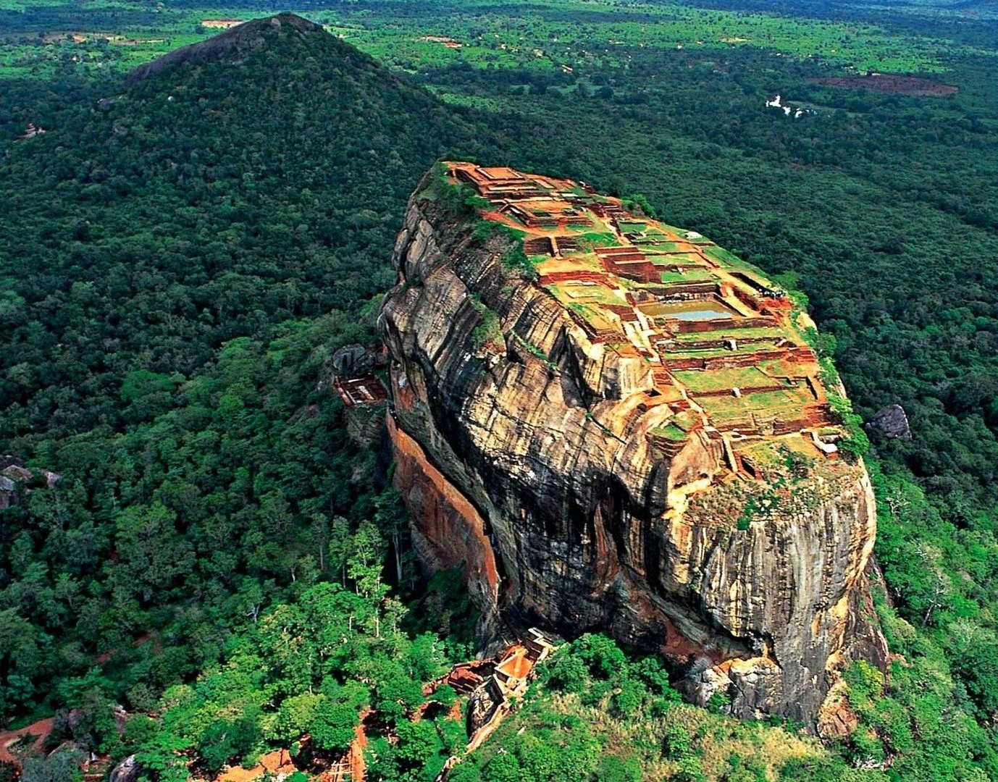
Advanced Intelligent Travel Guide
Group Members
142027
142083
142134
142190

Slide 2

Introduction

Slide 3

This project focuses mainly on tourists and travelers who visit Sri Lanka.
Since Sri Lanka is a famous destination among tourists and travelers, this system will assist tourists in gaining access to information on tourist locations in Sri Lanka.
The goal of this project is to use new trends and technologies of Artificial Intelligence, in the field of tourism and travel.

Slide 4

Problems

Slide 5
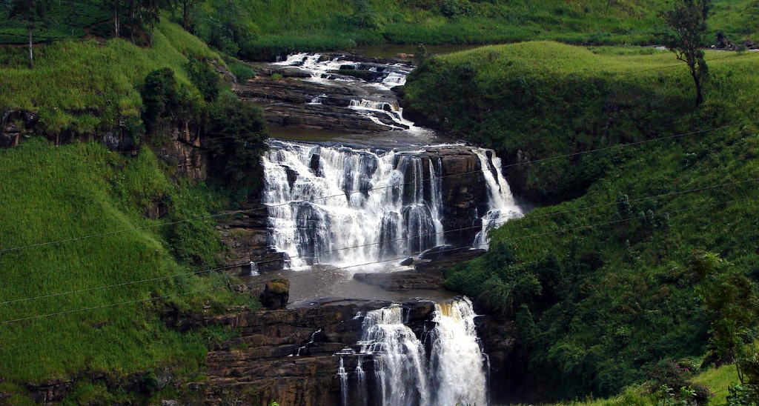
Most tourists are not capable of planning their time spend in Sri Lanka.
In modern era due to rapid advancements in information technology, information overload has become a serious issue.
Many tourist guides available in web. In some situations, there can be issues accessing those web sites from mobile phones.

Slide 6

Objectives

Slide 7

User gets the recommendation of the places of their preferences and they can find the places using this system.
User can easily view a place with its description, image and address.
Create a System GUI easy to use and the system in robust and secure in nature.

Slide 8
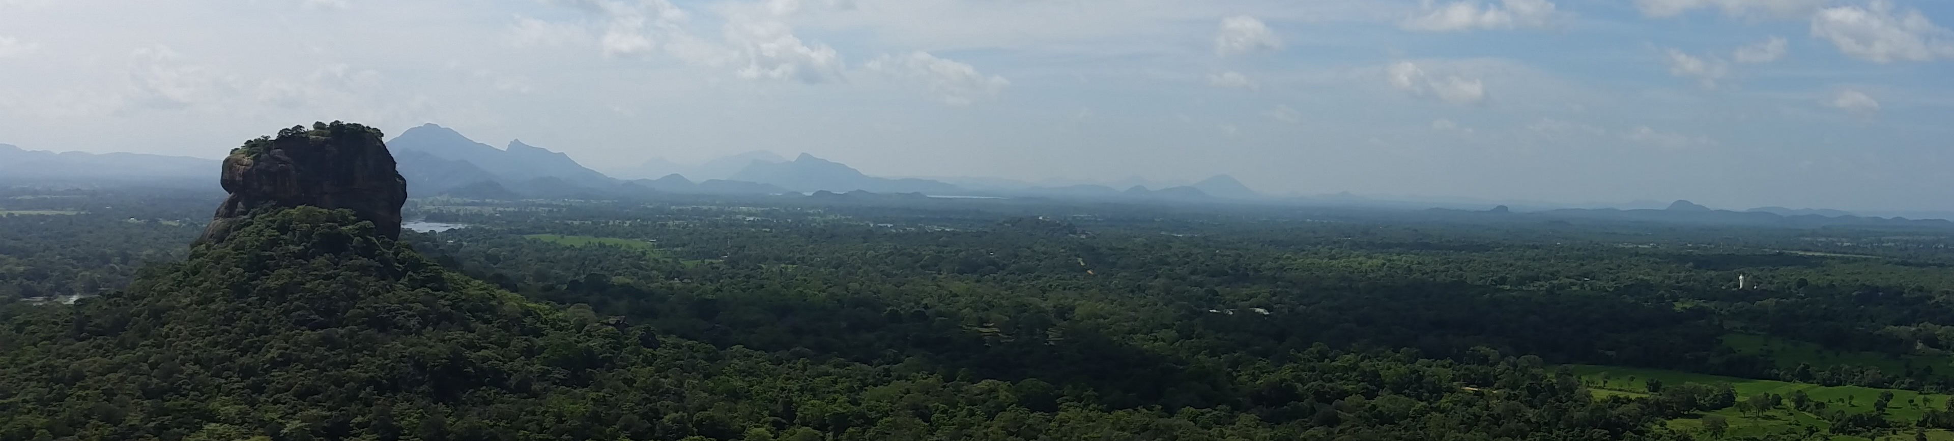
Identified Solutions

Slide 9

A set of questionnaire which the user has to answer.
Based on answers, 2 best results will be provided.
The user can get description of spots/locations along with the pictures by clicking on results.

Slide 10

Methodology

Slide 11
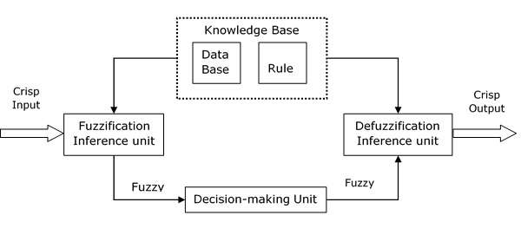
Fuzzy Inference Systems

Slide 12
The steps of fuzzy reasoning (inference operations upon fuzzy IF–THEN rules) performed by FISs are:
1. Compare the input variables with the membership functions on the first part to obtain the membership values of each linguistic label. (this step is often called fuzzification.)
2. Combine (usually multiplication or min) the membership values on the premise part to get firing strength of each rule.
3. Generate the qualified consequents (either fuzzy or crisp) or each rule depending on the firing strength.
4. Aggregate the qualified consequents to produce a crisp output. (This step is called defuzzification.)

Slide 13
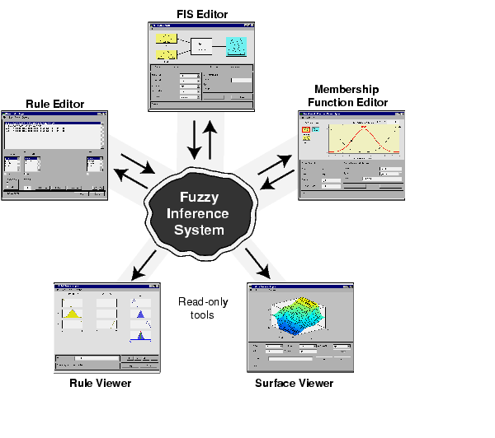
Building system with the fuzzy logic toolbox
In the present study, the GUI (Graphical User Interface) tools are used, which basically consists of five editors to build, edit and view the system

Slide 14
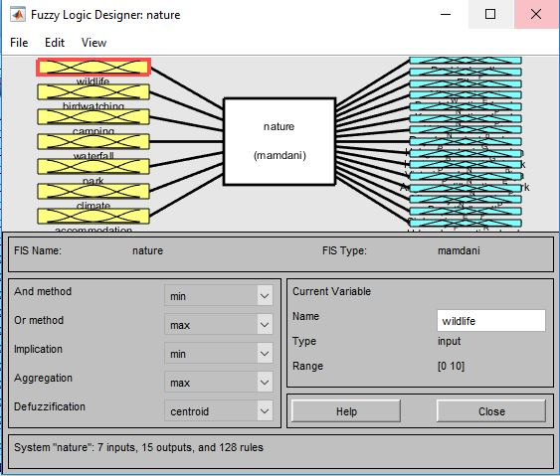
1) Fuzzy Inference System (FIS) Editor
to handle the high level issues for the system like number of input and output variables and their names.

Slide 15
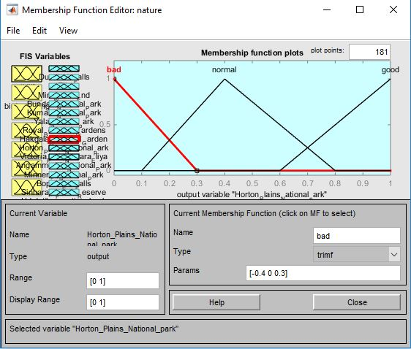
2) Membership Function Editor
to define the shapes of all the membership functions associated with each variable.

Slide 16
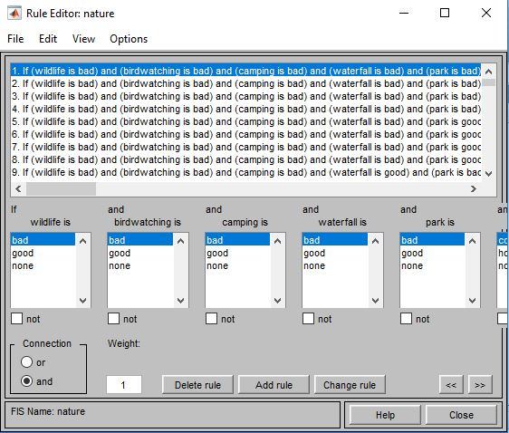
3) Rule Editor
to edit the list of rules that defines the behavior of the system.

Slide 17
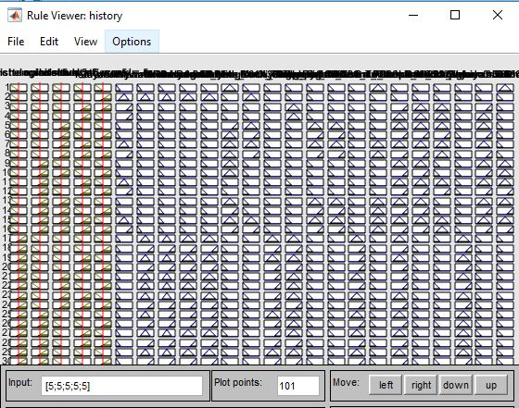
4) Rule Viewer
to view the fuzzy inference diagram. This viewer is used as a diagnostic to see, for example, which rules are active, or how individual membership function shapes influence the results.

Slide 18
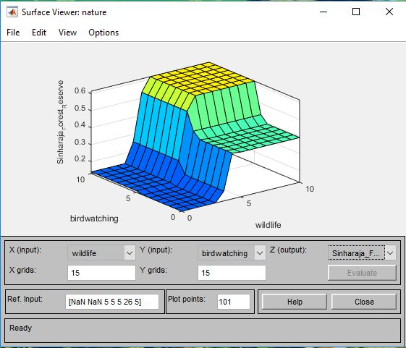
5) Surface Viewer
to view the dependency of one of the outputs on any one or two of the inputs. It generates and plots an output surface map for the system.

Slide 19
Tools

Slide 20
MATLAB
Fuzzy tool box

Slide 21
Results

Slide 22
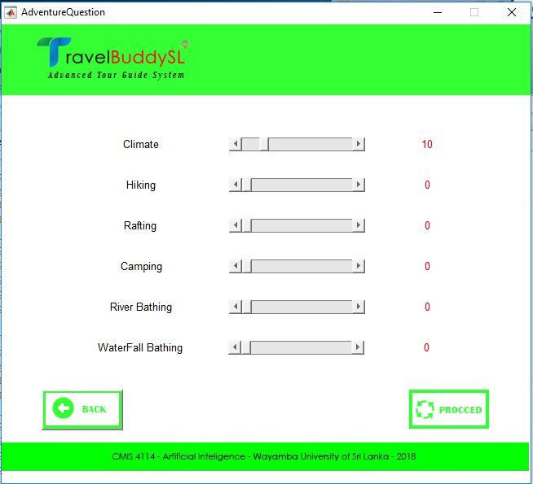
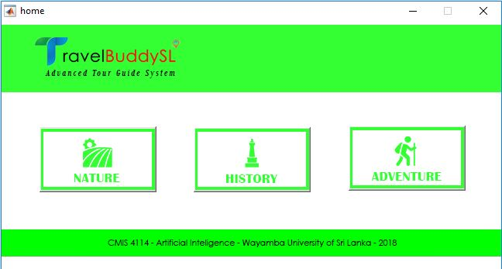
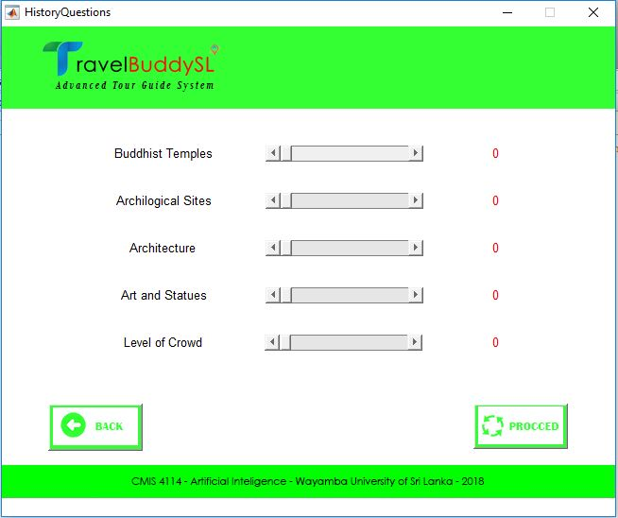
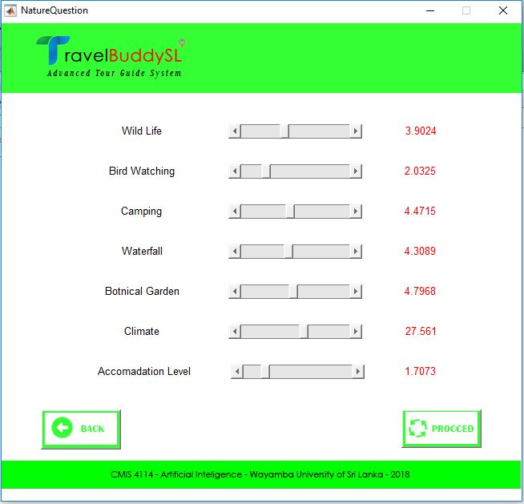

Slide 23
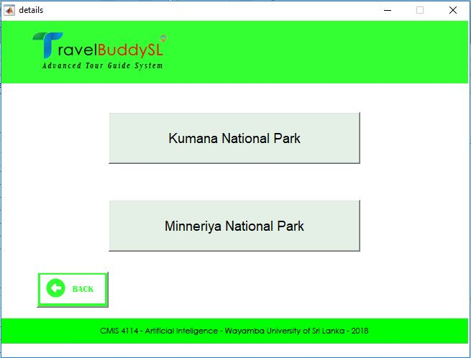


Slide 24

THANK YOU!

